Slide 1




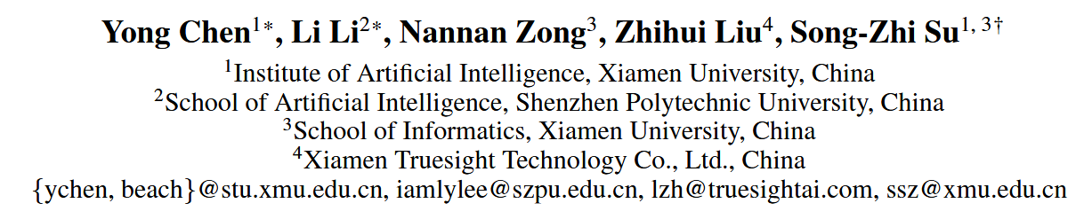



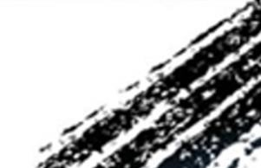

ATAI
Advanced Technique of Artificial Intelligence
ATAI
ChongqingUniversity _{AdvancedTechniqueof}
of Technology Artificial Intelligence
Chongqing University of
Technology
Chongqing University ^{ATAI}
_{of Technology} Advanced Techniqueof
Artificial Intelligence
Chongqing University of Technology
Chongqing University of Technology
Anisotropic Residual Diffusion for Heterogeneous Graph Learning
Code : https://github.com/s35lay/ARDiff
——AAAI_2026
Reported by Yuhang Jang
1

Slide 2
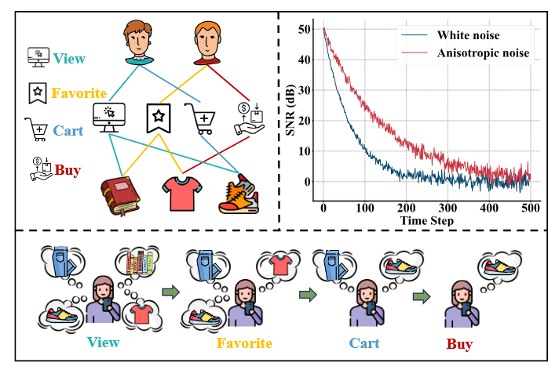
ATAI
Advanced Technique of Artificial Intelligence
ATAI
ChongqingUniversity _{AdvancedTechniqueof}
of Technology Artificial Intelligence
Chongqing University of
Technology
Chongqing University ^{ATAI}
_{of Technology} Advanced Techniqueof
Artificial Intelligence
Chongqing University of Technology
Chongqing University of Technology
Motivation
1) Existing multi-behavior recommendation methods mainly capture the static preference information of each behavior and overlook the fine-grained semantic transitions between different behavioral intentions.
2) During diffusion, isotropic noise ignores the underlying graph structure and may introduce structure-unaware perturbations, resulting in severe semantic degradation and difficulty in reverse recovery. Anisotropic noise leverages neighborhood semantic directions to generate structure-aware perturbations, thereby improving the quality of the reverse denoising process.
Notes:
同质图：节点都是一种类型，例如“用户”。边也是一种类型， “交互”。U-I图其实就是异构图

Slide 3
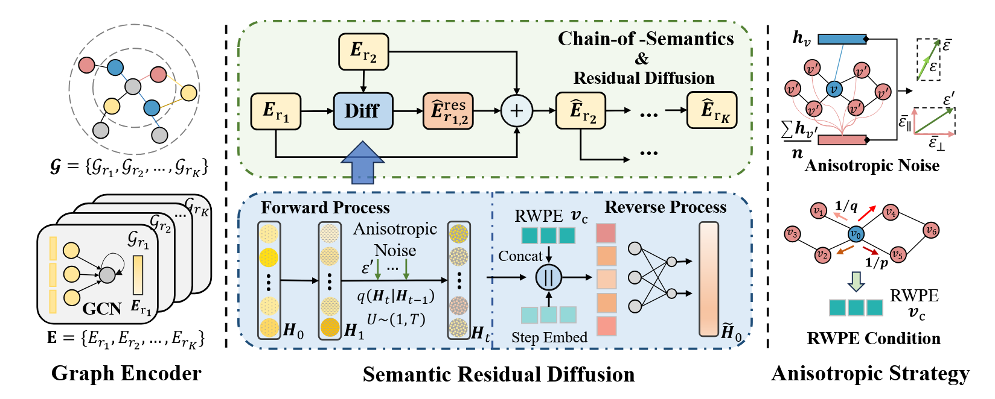
ATAI
Advanced Technique of Artificial Intelligence
ATAI
ChongqingUniversity _{AdvancedTechniqueof}
of Technology Artificial Intelligence
Chongqing University of
Technology
Chongqing University ^{ATAI}
_{of Technology} Advanced Techniqueof
Artificial Intelligence
Chongqing University of Technology
Chongqing University of Technology
Method

Slide 4
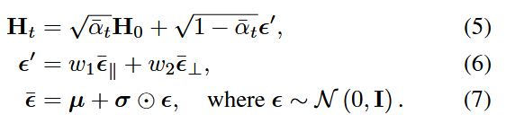




ATAI
Advanced Technique of Artificial Intelligence
ATAI
ChongqingUniversity _{AdvancedTechniqueof}
of Technology Artificial Intelligence
Chongqing University of
Technology
Chongqing University ^{ATAI}
_{of Technology} Advanced Techniqueof
Artificial Intelligence
Chongqing University of Technology
Chongqing University of Technology
Method

Slide 5




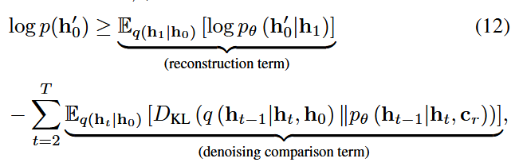

ATAI
Advanced Technique of Artificial Intelligence
ATAI
ChongqingUniversity _{AdvancedTechniqueof}
of Technology Artificial Intelligence
Chongqing University of
Technology
Chongqing University ^{ATAI}
_{of Technology} Advanced Techniqueof
Artificial Intelligence
Chongqing University of Technology
Chongqing University of Technology
Method
Notes:
用子注意力进行融合q为当前模态，k与v为其他模态信息

Slide 6

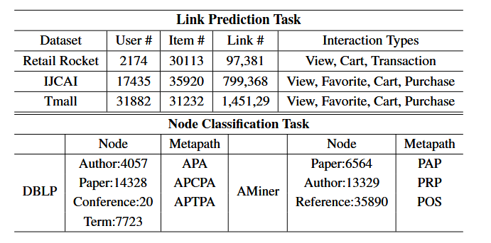
ATAI
Advanced Technique of Artificial Intelligence
ATAI
ChongqingUniversity _{AdvancedTechniqueof}
of Technology Artificial Intelligence
Chongqing University of
Technology
Chongqing University ^{ATAI}
_{of Technology} Advanced Techniqueof
Artificial Intelligence
Chongqing University of Technology
Chongqing University of Technology

Slide 7
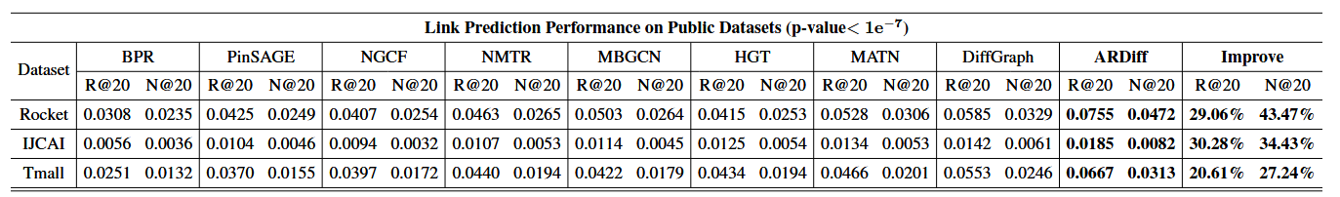
ATAI
Advanced Technique of Artificial Intelligence
ATAI
ChongqingUniversity _{AdvancedTechniqueof}
of Technology Artificial Intelligence
Chongqing University of
Technology
Chongqing University ^{ATAI}
_{of Technology} Advanced Techniqueof
Artificial Intelligence
Chongqing University of Technology
Chongqing University of Technology

Slide 8
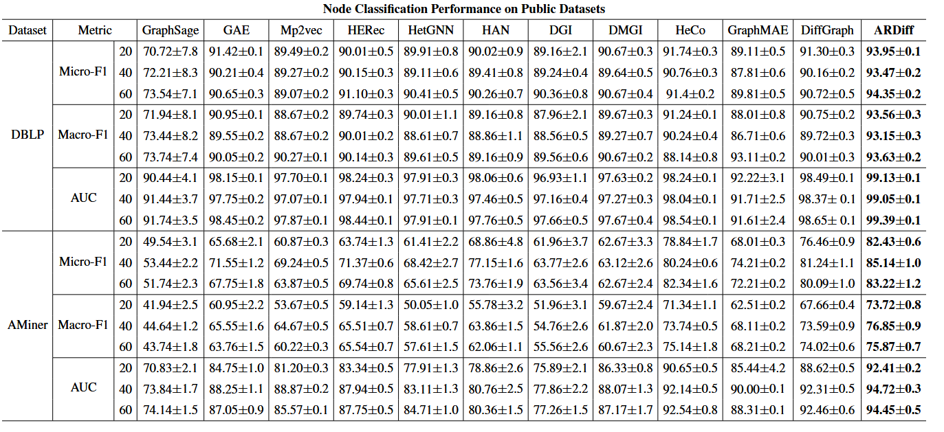
ATAI
Advanced Technique of Artificial Intelligence
ATAI
ChongqingUniversity _{AdvancedTechniqueof}
of Technology Artificial Intelligence
Chongqing University of
Technology
Chongqing University ^{ATAI}
_{of Technology} Advanced Techniqueof
Artificial Intelligence
Chongqing University of Technology
Chongqing University of Technology

Slide 9
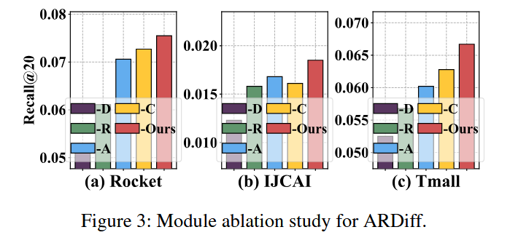
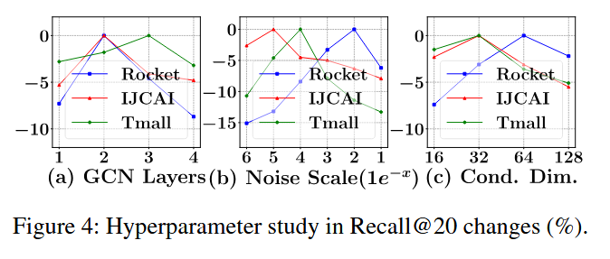
ATAI
Advanced Technique of Artificial Intelligence
ATAI
ChongqingUniversity _{AdvancedTechniqueof}
of Technology Artificial Intelligence
Chongqing University of
Technology
Chongqing University ^{ATAI}
_{of Technology} Advanced Techniqueof
Artificial Intelligence
Chongqing University of Technology
Chongqing University of Technology
Notes:
第三个实验，可以发现当越晚后面会出现信息比较少，使用其他的模态信息补齐可以缓解

Slide 10
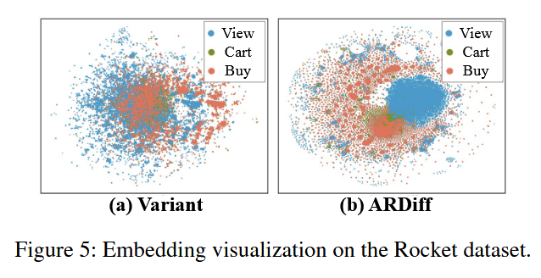
ATAI
Advanced Technique of Artificial Intelligence
ATAI
ChongqingUniversity _{AdvancedTechniqueof}
of Technology Artificial Intelligence
Chongqing University of
Technology
Chongqing University ^{ATAI}
_{of Technology} Advanced Techniqueof
Artificial Intelligence
Chongqing University of Technology
Chongqing University of Technology

Slide 11


ATAI
Advanced Technique of Artificial Intelligence
ATAI
ChongqingUniversity _{AdvancedTechniqueof}
of Technology Artificial Intelligence
Chongqing University of
Technology
Chongqing University ^{ATAI}
_{of Technology} Advanced Techniqueof
Artificial Intelligence
Chongqing University of Technology
Chongqing University of Technology
Thanks!

